Slide 1

Parallel & Distributed Computing Lecture 9: MPP Algorithm Design and Laws
Farhad M. Riaz
Farhad.Muhammad@numl.edu.pk
Department of Computer Science
NUML, Islamabad

Slide 2
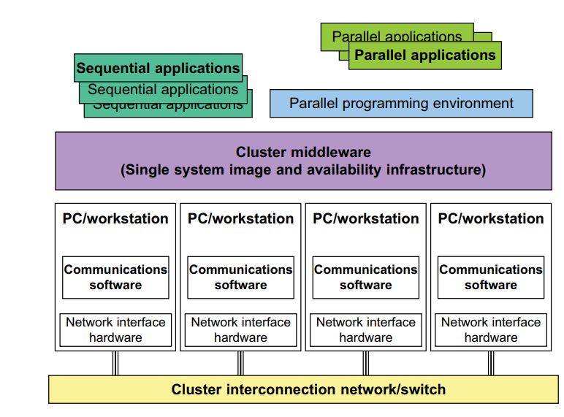
Basic Cluster Architecture
Notes:
Figure shows the architecture of a computer cluster built with commodity hardware, software, middleware, and network components supporting HA and SSI.
The processing nodes are commodity workstations, PCs, or servers. These commodity nodes are easy to replace or upgrade with new generations of hardware. The node operating systems should be designed for multiuser, multitasking, and multithreaded applications. The nodes are interconnected by one or more fast commodity networks. These networks use standard communication protocols and operate at a speed that should be two orders of magnitude faster than that of the current TCP/IP speed over Ethernet. The network interface card is connected to the node’s standard I/O bus (e.g., PCI). When the processor or the operating system is changed, only the driver software needs to change. We desire to have a platform-independent cluster operating system, sitting on top of the node platforms. But such a cluster OS is not commercially available. Instead, we can deploy some cluster middleware to glue together all node platforms at the user space. An availability middleware offers HA services. An SSI layer provides a single entry point, a single file hierarchy, a single point of control, and a single job management system. Single memory may be realized with the help of the compiler or a runtime library. A single process space is not necessarily supported. In general, an idealized cluster is supported by three subsystems. First, conventional databases and OLTP monitors offer users a desktop environment in which to use the cluster. In addition to running sequential user programs, the cluster supports parallel programming based on standard languages and communication libraries using PVM, MPI, or OpenMP. The programming environment also includes tools for debugging, profiling, monitoring, and so forth. A user interface subsystem is needed to combine the advantages of the web interface and the Windows GUI. It should also provide user-friendly links to various programming environments, job management tools, hypertext, and search support so that users can easily get help in programming the computer cluster.

Slide 3
Basic Cluster Architecture
The processing nodes are commodity workstations, PCs, or servers.
These commodity nodes are easy to replace or upgrade with new generations of hardware.
The node operating systems should be designed for multiuser, multitasking, and multithreaded applications. The nodes are interconnected by one or more fast commodity networks.
These networks use standard communication protocols and operate at a speed that should be two orders of magnitude faster than that of the current TCP/IP speed over Ethernet.
The network interface card is connected to the node’s standard I/O bus (e.g., PCI). When the processor or the operating system is changed, only the driver software needs to change.
We desire to have a platform-independent cluster operating system, sitting on top of the node platforms. But such a cluster OS is not commercially available.
Instead, we can deploy some cluster middleware to glue together all node platforms at the user space.
An availability middleware offers HA services.
An SSI layer provides a single entry point, a single file hierarchy, a single point of control, and a single job management system.
Single memory may be realized with the help of the compiler or a runtime library.
A single process space is not necessarily supported.
In general, an idealized cluster is supported by three subsystems.
First, conventional databases and OLTP monitors offer users a desktop environment in which to use the cluster.
In addition to running sequential user programs, the cluster supports parallel programming based on standard languages and communication libraries using PVM, MPI, or OpenMP.
The programming environment also includes tools for debugging, profiling, monitoring, and so forth.
A user interface subsystem is needed to combine the advantages of the web interface and the Windows GUI. It should also provide user-friendly links to various programming environments, job management tools, hypertext, and search support so that users can easily get help in programming the computer cluster.

Slide 4
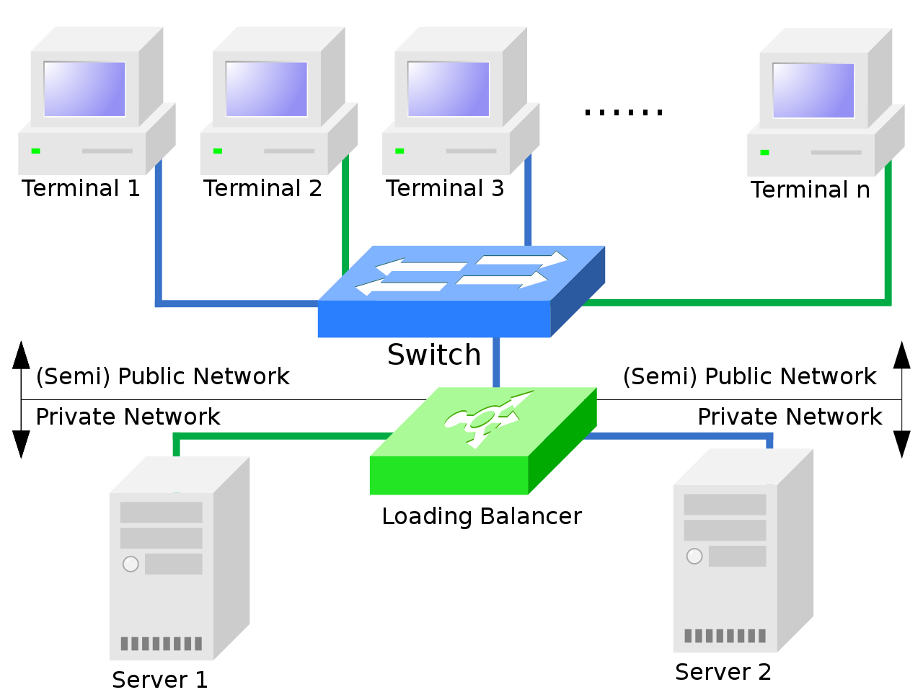
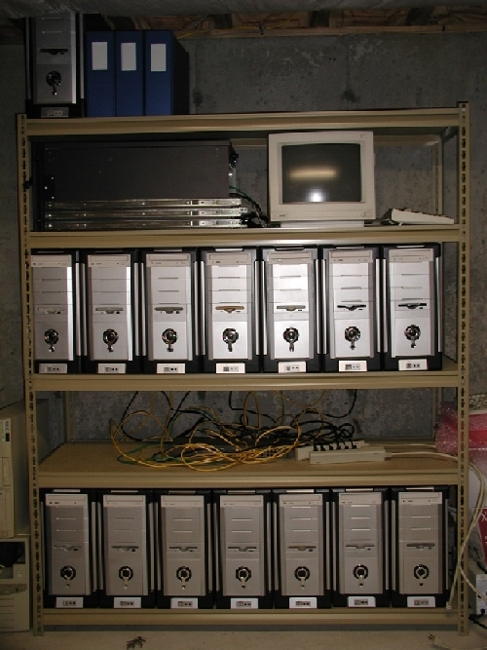
How does Cluster look?
A load balancing cluster with two servers and N user stations.
Simple home-based cluster

Slide 5
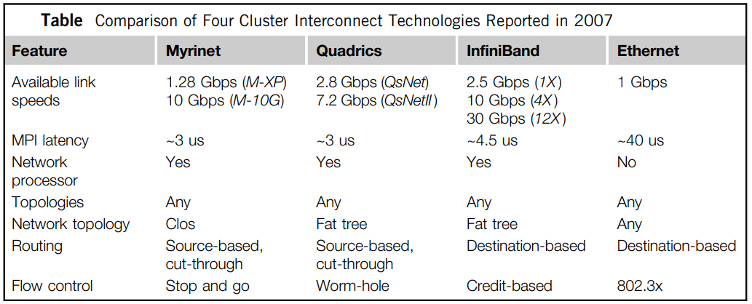
Cluster System Interconnects

Slide 6
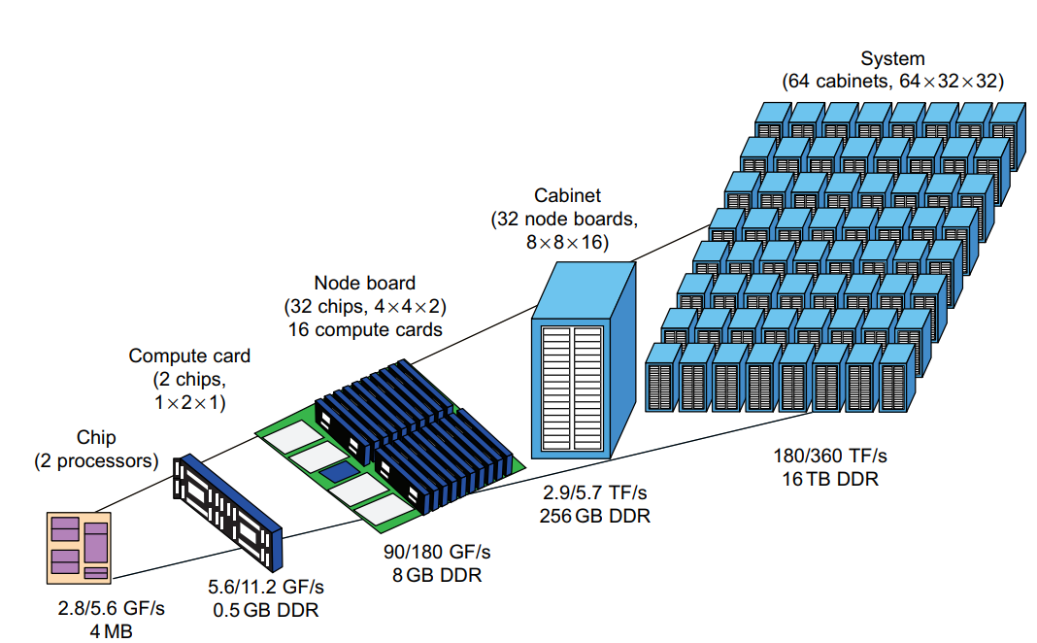
Node Architectures and MPP Packaging
Cluster nodes are classified as: compute nodes and service nodes.
For MPP clusters, the compute nodes dominate in system cost, because we may have 1,000 times more compute nodes than service nodes in a single large clustered system.
Notes:
Compute nodes appear in larger quantities mainly used for largescale searching or parallel floating-point computations. Service nodes could be built with different processors mainly used to handle I/O, file access, and system monitoring.
In the past, most MPPs are built with a homogeneous architecture by interconnecting a large number of the same compute nodes. In 2010, the Cray XT5 Jaguar system was built with 224,162 AMD Opteron processors with six cores each. The Tiahe-1A adopted a hybrid node design using two Xeon CPUs plus two AMD GPUs per each compute node. The GPU could be replaced by special floating-point accelerators. A homogeneous node design makes it easier to program and maintain the system.

Slide 7
Node Architectures and MPP Packaging
Compute nodes appear in larger quantities mainly used for largescale searching or parallel floating-point computations. Service nodes could be built with different processors mainly used to handle I/O, file access, and system monitoring.
In the past, most MPPs are built with a homogeneous architecture by interconnecting a large number of the same compute nodes. In 2010, the Cray XT5 Jaguar system was built with 224,162 AMD Opteron processors with six cores each. The Tiahe-1A adopted a hybrid node design using two Xeon CPUs plus two AMD GPUs per each compute node. The GPU could be replaced by special floating-point accelerators. A homogeneous node design makes it easier to program and maintain the system.

Slide 8
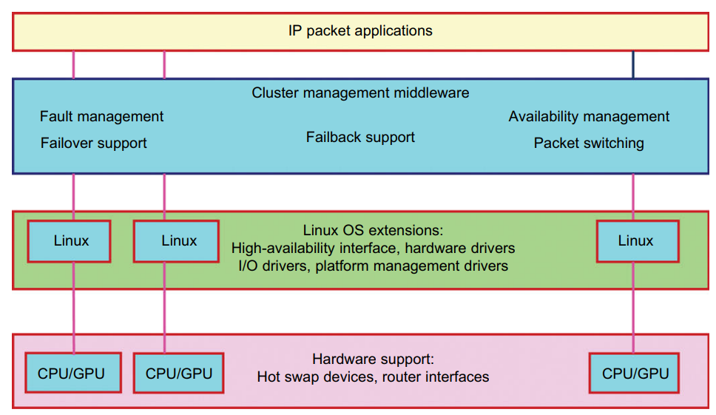
Hardware, Software, and Middleware Support
SSI (Single System Image) and HA (High Availability)features in a cluster are not obtained free of charge.
They must be supported by hardware, software, middleware, or OS extensions.
Any change in hardware design and OS extensions must be done by the manufacturer.

Slide 9
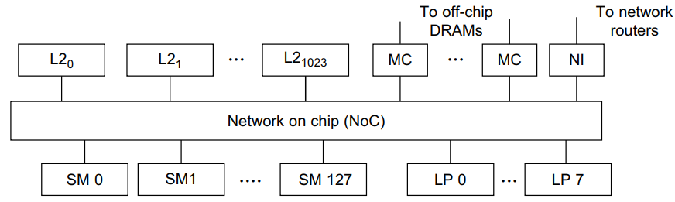
GPU Clusters for Massive Parallelism
GPUs are becoming high-performance accelerators for data-parallel computing.
The high performance of a GPU cluster is attributed
massively parallel multicore
high throughput
significantly reduced time
GPU clusters already are more cost-effective than traditional CPU clusters.
The proposed GPU chip design for 20 Tflops performance and 1.6 TB/s memory bandwidth
Notes:
Recent HPC-optimized GPUs contain up to 4 GB of on-board memory, and are capable of sustaining memory bandwidths exceeding 100 GB/second. GPU clusters are built with a large number of GPU chips. GPU clusters have already demonstrated their capability to achieve Pflops performance in some of the Top 500 systems. Most GPU clusters are structured with homogeneous GPUs of the same hardware class, make, and model. The software used in a GPU cluster includes the OS, GPU drivers, and clustering API such as an MPI. The high performance of a GPU cluster is attributed mainly to its massively parallel multicore architecture, high throughput in multithreaded floating-point arithmetic, and significantly reduced time in massive data movement using large on-chip cache memory. In other words, GPU clusters already are more cost-effective than traditional CPU clusters. GPU clusters result in not only a quantum jump in speed performance, but also significantly reduced space, power, and cooling demands. A GPU cluster can operate with a reduced number of operating system images, compared with CPU-based clusters. These reductions in power, environment, and management complexity make GPU clusters very attractive for use in future HPC applications.

Slide 10
GPU Clusters for Massive Parallelism
Recent HPC-optimized GPUs contain up to 4 GB of on-board memory, and are capable of sustaining memory bandwidths exceeding 100 GB/second.
GPU clusters are built with a large number of GPU chips.
GPU clusters have already demonstrated their capability to achieve Pflops performance in some of the Top 500 systems.
Most GPU clusters are structured with homogeneous GPUs of the same hardware class, make, and model.
The software used in a GPU cluster includes the OS, GPU drivers, and clustering API such as an MPI.
The high performance of a GPU cluster is attributed mainly to its massively parallel multicore architecture, high throughput in multithreaded floating-point arithmetic, and significantly reduced time in massive data movement using large on-chip cache memory.
In other words, GPU clusters already are more cost-effective than traditional CPU clusters.
GPU clusters result in not only a quantum jump in speed performance, but also significantly reduced space, power, and cooling demands.
A GPU cluster can operate with a reduced number of operating system images, compared with CPU-based clusters.
These reductions in power, environment, and management complexity make GPU clusters very attractive for use in future HPC applications.

Slide 11
Designing Parallel Programs
Automatic vs. Manual Parallelization
Characteristically been a very manual process
Programmer’s responsibility
Very often, manually developing parallel codes is a time consuming, complex, error-prone and iterative process
Various tools have been available to assist the programmer with converting serial programs into parallel programs
Fully Automatic
Programmer Directed

Slide 12
Understand the Problem and Program
Understanding the existing Serial code
Determine whether the problem is one that can be parallelized
Example of a problem with little-to-no parallelism:
Calculation of the Fibonacci series (0,1,1,2,3,5,8,13,21,...) by use of the formula: F(n) = F(n-1) + F(n-2)

Slide 13
Understand the Problem and Program
Identify the program's hotspots
Know where most of the real work is being done
Profilers and performance analysis tools can help here
Focus on parallelizing the hotspots and ignore those sections of the program that account for little CPU usage
Identify bottlenecks in the program
Are there areas that are disproportionately slow, or cause parallelizable work to halt
Restructure the program or use a different algorithm to reduce or eliminate unnecessary slow areas

Slide 14
Understand the Problem and Program
Identify inhibitors to parallelism
Investigate other algorithms if possible
Take advantage of optimized third-party parallel software and highly optimized math libraries

Slide 15
Partitioning
One of the first steps in designing a parallel program is to break the problem into discrete "chunks" of work
There are two basic ways to partition
Domain decomposition
Functional decomposition

Slide 16
Domain Decomposition
In this type of partitioning, the data associated with a problem is decomposed. Each parallel task then works on a portion of the data
There are different ways to partition data:

Slide 17
Functional Decomposition
The focus is on the computation that is to be performed rather than on the data manipulated by the computation
The problem is decomposed according to the work that must be done
Functional decomposition lends itself well to problems that can be split into different tasks e.g. Ecosystem Modeling, Signal Processing

Slide 18
Who Needs Communications?
DON'T need communication
DO need communication
Embarrassingly parallel; virtually no need for tasks to share data e.g. Every pixel in a black and white image needs to have its color reversed.
Most parallel applications do require tasks to share data e.g. a 2-D heat diffusion problem

Slide 19
Communications Factors to Consider:
Communication overhead
Inter-task communication virtually always implies overhead.
Machine cycles and resources that could be used for computation are instead used to package and transmit data
Synchronization between tasks results in tasks spending time "waiting" instead of doing work
Competing communication traffic can saturate the available network bandwidth

Slide 20
Communications Factors to Consider:
Latency vs. Bandwidth
latency is the time it takes to send a minimal (0 byte) message from point A to point B. Commonly expressed as microseconds.
bandwidth is the amount of data that can be communicated per unit of time. Commonly expressed as megabytes/sec or gigabytes/sec
Sending many small messages can cause latency to dominate communication overheads
Often it is more efficient to package small messages into a larger message, thus increasing the effective communications bandwidth.

Slide 21
Communications Factors to Consider:
Visibility of communications
With the Message Passing Model, communications are explicit and generally quite visible and under the control of the programmer
With the Data Parallel Model, communications often occur transparently to the programmer. The programmer not able to know how inter-task communications being accomplished

Slide 22
Communications Factors to Consider:
Synchronous vs. asynchronous communications
Synchronous communications: "handshaking" between tasks that are sharing data, Explicitly structured in code by the programmer, or it may happen at a lower level unknown to the programmer.
Synchronous communications are often referred to as blocking communications since other work must wait until the communications have completed.
Asynchronous communications allow tasks to transfer data independently from one another
Asynchronous communications are often referred to as non-blocking communications
Interleaving computation with communication is the single greatest benefit for using asynchronous communications

Slide 23
Scope of communications
Point-to-point - involves two tasks with one task acting as the sender/producer of data, and the other acting as the receiver/consumer.
Collective - involves data sharing between more than two tasks, which are often specified as being members in a common group, or collective.

Slide 24
Efficiency of communications
Choices that can affect communications performance
Which implementation for a given model should be used? e.g. one MPI implementation may be faster on a given hardware platform than another
What type of communication operations should be used? E.g. asynchronous communication operations can improve overall program performance
Network fabric - different platforms use different networks. Some networks perform better than others

Slide 25
Synchronization
Managing the sequence of work and the tasks performing it is a critical design consideration for most parallel programs
Can be a significant factor in program performance (or lack of it)
Often requires "serialization" of segments of the program.

Slide 26
MPP High Availability through Redundancy
When designing robust, highly available systems three terms are often used together: reliability, availability, and serviceability (RAS)
Availability and Failure Rate
Availability = MTTF/(MTTF + MTTR)
Planned versus Unplanned Failure
Redundancy Techniques
Notes:
Reliability measures how long a system can operate without a breakdown. Availability indicates the percentage of time that a system is available to the user, that is, the percentage of system uptime. Serviceability refers to how easy it is to service the system, including hardware and software maintenance, repair, upgrades, and so on.
The failed system is then repaired, and the system returns to normal operation. This operate-repair cycle then repeats. A system’s reliability is measured by the mean time to failure (MTTF), which is the average time of normal operation before the system (or a component of the system) fails. The metric for serviceability is the mean time to repair (MTTR), which is the average time it takes to repair the system and restore it to working condition after it fails.
Redundancy Techniques

Slide 27
Fault-Tolerant Cluster Configurations
Level of availability increases from standby to active and fault-tolerant cluster configurations.
Failback refers to the ability of a recovered node returning to normal operation after repair or maintenance.
Activeness refers to whether the node is used in active work during normal operation.

Slide 28
Fault-Tolerant Cluster Configurations
Hot standby server clusters
Active-takeover clusters
Failover cluster
Notes:
Hot standby server clusters
Only the primary node is actively doing all the useful work normally.
Standby node is powered on (hot) and running some monitoring programs to communicate heartbeat signals to check the status of the primary node but is not actively running other useful workloads.
The primary node must mirror any data to shared disk storage, which is accessible by the standby node.
The standby node requires a second copy of data.
Active-takeover clusters
In this case, the architecture is symmetric among multiple server nodes. Both servers are primary, doing useful work normally. Both failover and failback are often supported on both server nodes. When a node fails, the user applications fail over to the available node in the cluster. Depending on the time required to implement the failover, users may experience some delays or may lose some data that was not saved in the last checkpoint.
Failover cluster
This is probably the most important feature demanded in current clusters for commercial applications. When a component fails, this technique allows the remaining system to take over the services originally provided by the failed component. A failover mechanism must provide several functions, such as failure diagnosis, failure notification, and failure recovery. Failure diagnosis refers to the detection of a failure and the location of the failed component that caused the failure. A commonly used technique is heartbeat, whereby the cluster nodes send out a stream of heartbeat messages to one another. If the system does not receive the stream of heartbeat messages from a node, it can conclude that either the node or the network connection has failed.

Slide 29
Fault-Tolerant Cluster Configurations
Hot standby server clusters
Only the primary node is actively doing all the useful work normally.
Standby node is powered on (hot) and running some monitoring programs to communicate heartbeat signals to check the status of the primary node but is not actively running other useful workloads.
The primary node must mirror any data to shared disk storage, which is accessible by the standby node.
The standby node requires a second copy of data.
Active-takeover clusters
In this case, the architecture is symmetric among multiple server nodes. Both servers are primary, doing useful work normally. Both failover and failback are often supported on both server nodes. When a node fails, the user applications fail over to the available node in the cluster. Depending on the time required to implement the failover, users may experience some delays or may lose some data that was not saved in the last checkpoint.
Failover cluster
This is probably the most important feature demanded in current clusters for commercial applications. When a component fails, this technique allows the remaining system to take over the services originally provided by the failed component. A failover mechanism must provide several functions, such as failure diagnosis, failure notification, and failure recovery. Failure diagnosis refers to the detection of a failure and the location of the failed component that caused the failure. A commonly used technique is heartbeat, whereby the cluster nodes send out a stream of heartbeat messages to one another. If the system does not receive the stream of heartbeat messages from a node, it can conclude that either the node or the network connection has failed.

Slide 30
That’s all for today!!

